Slide 1
Standalone ERP Management System for Industries
Team Name

Slide 2
1. Project Overview
Current Presenter:
Student’s Full Name
Client:
Dilip Singh, CEO, Innovatus Technologies
Client’s business:
Innovatus has provided satisfied service to their CRM and ERP clients in India and abroad and managed to grow in different sectors in software industry.

Slide 3
1. Project Overview (cont)
Current Presenter:
Student’s Full Name
Client’s “problem” to be solved:
The ERP’s have been highly useful for the purpose of effectively organizing and improving the management of large corporations across the world.
This meant the medium and the small scale approaches have not been considered for this kind of deployment due to the cost and the lack of organizational structure.
This was highly focused on the large industries can companies as they could afford such a deployment at a massive scale, along with the development costs of the same.

Slide 4
1. Project Overview (cont)
Current Presenter:
Student’s Full Name
The proposed the solution:
In the proposed approach, an ERP for medium/small scale organization has been envisioned. The devised system will contain 3 distinct use cases such as, employee, Managers and of the Owner/CEO of the organization.
Once the employee creates a profile and logs into the system, they can access the payroll, accounts receivable, accounts payable, invoices, etc.
The Manager will be displayed performance and the details about all the employees along with the capabilities to realize Human Resource functionalities along with self-servicing rights.

Slide 5
2. Requirements (& demo)
Current Presenter:
Student’s Full Name
CEO and his Operations
The CEO can access the system after providing the valid credentials and successful authentication.
After successful authentication the CEO is greeted with the Dashboard as the operation frame with a menu based interactive user interface.

Slide 6
2. Requirements (& demo)
Current Presenter:
Student’s Full Name
The CEO can access the Home Company information and edit id from the Home menu present on the Dashboard.
The Sales report also can be viewed by the CEO through the selection of sales report option from the Report Menu on the Dashboard.
The Purchase report also can be viewed by the CEO through the selection of purchase report option from the Report Menu on the Dashboard.

Slide 7
2. Requirements (& demo)
Current Presenter:
Student’s Full Name
Manager and his Operations.
The Manager can gain authorized access into the ERP system through the use of valid credentials.
After successful authentication the Manager is greeted with the Dashboard as the operation frame which is a menu based interactive user interface for performing the various duties of the manager.

Slide 8
2. Requirements (& demo)
Current Presenter:
Student’s Full Name
The Manager can access the Home Menu from the dashboard to add the home company and its detailed information into the ERP system.
The Manager can also edit the Home company information by accessing the home button on the Dashboard and selecting the edit home company information button.
The manager has the staff button on the dashboard menu which can be used to create an entry for a new staff member.

Slide 9
2. Requirements (& demo)
Current Presenter:
Student’s Full Name
The existing staff can also be viewed by the manager through the use of the same staff menu on the dashboard. This also allows the editing of the details of the existing staff member by selecting it using the edit button.
The staff report is also managed by the manager through the selection of staff report on the manager dashboard.
The staff attendance can also be viewed by the manager by accessing the Staff menu on the dashboard and viewing the attendance.

Slide 10
2. Requirements (& demo)
Current Presenter:
Student’s Full Name
The manager can also view the payment details from the staff payment options to better manage the disbursements to the employer.
The Sales report also can be viewed by the Manager through the selection of sales report option from the Report Menu on the Dashboard.
The Purchase report also can be viewed by the Manager through the selection of purchase report option from the Report Menu on the Dashboard.

Slide 11
2. Requirements (& demo)
Current Presenter:
Student’s Full Name
Staff and their Operations.
The staff is authenticated and their credentials are validated by the system before providing access to the Staff dashboard.
Once the staff gains access into the ERP system, they are greeted with interactive user interface, consisting of the various options in the form of menus.

Slide 12
2. Requirements (& demo)
Current Presenter:
Student’s Full Name
The Staff are able to a particular client by accessing the ad client option from the Manage Client menu on the dashboard.
After the registration of the clients, the pre-registered clients can be searched through the register client search detail page to retrieve the respective client which can be selected for Editing the attributes or deletion.
The Staff are able to add an item along with the entire details of the item to the system through the use of the add item option in the Dashboard.

Slide 13
2. Requirements (& demo)
Current Presenter:
Student’s Full Name
The staff also has the capability to search for a pre-existing item on the ERP system through the use of the Search item feature from the dashboard. This retrieves the list of matching items on system which can then be selected for editing or deletion.
A new purchase is added by the staff through the use of purchase menu and clicking the new purchase option.
The purchases can also be searched by the staff through the use of the search purchases option. Once the relevant purchase results are retrieved, the staff can either edit the purchase or download it.

Slide 14
2. Requirements (& demo)
Current Presenter:
Student’s Full Name
The payment of the purchase can be made by the use of the purchase payment option which can be selected from the purchase menu on the staff dashboard. The staff can print the receipt and save the transaction.
An Advance payment for the system can be handled effectively by the staff using the advance purchase payment option from the staff dashboard.
A New sale for the company can be easily added by the staff through the use of the new sale frame in the dashboard.

Slide 15
2. Requirements (& demo)
Current Presenter:
Student’s Full Name
The sales can be searched by the staff using the search sales option which retrieves the relevant results that can be edited by the staff.
The sale receipts can be generated by the staff through the use of the sale receipt menu that can be searched using a variety of attributes.
The staff is also equipped with the generation of the sale receipt for advance payments which is accessible from the Advance sale receipt menu on the Dashboard.

Slide 16
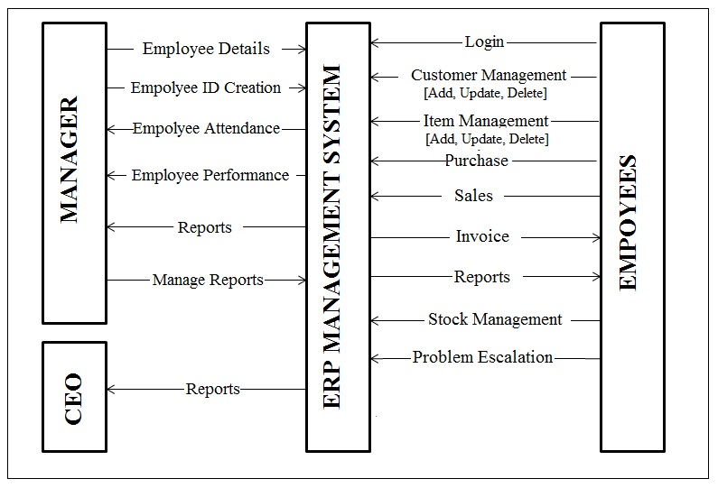
3. Design (Entity and Relationships)
Current Presenter:
Student’s Full Name

Slide 17
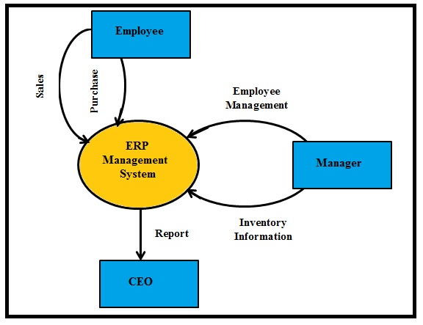
3. Design (Context Diagram)
Current Presenter:
Student’s Full Name

Slide 18
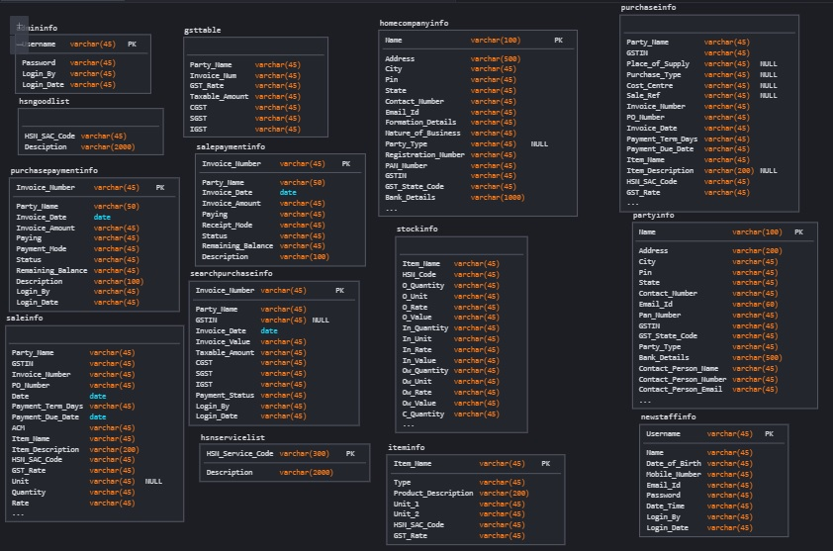
4. Implementation (Database Schema)
Current Presenter:
Student’s Full Name

Slide 19
4. Implementation
Current Presenter:
Student’s Full Name
The approach has been implemented in the java programming language as a standalone application. The challenges include the designing of the Graphical user interface through the use of Java Swings platform. The implementation of the machine learning approaches for effective and useful realization of the analysis in an accurate manner is highly necessary. The Database responsibilities have been handled by the MySQL Database server.

Slide 20
5. Testing (Manager)
Current Presenter:
Student’s Full Name
1.1 Test Cases for Manager Login and Edit
ID | TEST CASE DESCRIPTION | INPUT | PASS CRITERIA | FAIL CRITERIA
M_REG | Manager Registration. | Manager Details. | All the details are provided accurately. | Invalid Data entered.
M_LOGIN | Manager Login. | Manager Login Credentials. | Successful Login when valid credentials are entered. | Incorrect Credentials entered and respective pop up message is shown.
M_CHG_PASSWORD | Manager password update. | Manager updates password in the system. | New password is updated in the database successfully. | Passwords do not match or old password is incorrect and respective pop up message is shown.

Slide 21
5. Testing (Manager)
Current Presenter:
Student’s Full Name
1.2 Test Cases for managing home company information
ID | TEST CASE DESCRIPTION | INPUT | PASS CRITERIA | FAIL CRITERIA
M_ADD_COMPANY | Manager adds a new company. | Manager enters the General Information, statutory details and Bank details of the company. | Manager enters the correct company details and values for PIN number (6 digits), GSTIN (13 digits), PAN Number (10 characters), IFSC (11 characters) which are validated along with the other company data and stored successfully. | A respective pop up message is shown for all the encountered scenarios.
M_EDIT_COMPANY | Manager updates existing company details. | Manager updates the General Information, statutory details and Bank details of the company. | Manager updates the correct company details and values for PIN number (6 digits), GSTIN (13 digits), PAN Number (10 characters), IFSC (11 characters) which are validated along with the other company data and stored successfully. | A respective pop up message is shown for all the encountered scenarios.

Slide 22
5. Testing (Manager)
Current Presenter:
Student’s Full Name
1.3 Test Cases for Staff Details
ID | TEST CASE DESCRIPTION | INPUT | PASS CRITERIA | FAIL CRITERIA
M_ADD_STAFF | Manager adds staff details for staff account creation. | Manager Enters the relevant staff details. | Manager enters the relevant staff details correctly and in the right format which are validated and stored successfully. | A respective pop up message is shown for all the encountered scenarios.
M_EDIT_STAFF | Manager updates the Staff Details. | Manager Edits the selected Staff details. | Manager updates the relevant staff details correctly and in the right format which are validated and stored successfully in database. | A respective pop up message is shown for all the encountered scenarios.
M_STAFF_REPORT | Manager views Staff report. | Manager Action. | If Staff is created and the details are present, the relevant details are retrieved and displayed to the user. | If staff details are absent then a pop up message with the relevant error is displayed.

Slide 23
5. Testing (Manager)
Current Presenter:
Student’s Full Name
1.4 Test Cases for Report
ID | TEST CASE DESCRIPTION | INPUT | PASS CRITERIA | FAIL CRITERIA
M_SALE_REPORT | Manager views sale report. | Manager Action. | If sales are made and the details are present, the relevant graph is generated and displayed to the user. | If sales are absent then a pop up message with the relevant error is displayed.
M_PURCHASE_REPORT | Manager views purchase report. | Manager Action. | If purchases are made and the details are present, the relevant graph is generated and displayed to the user. | If purchases are absent then a pop up message with the relevant error is displayed.

Slide 24
5. Testing (CEO)
Current Presenter:
Student’s Full Name
2.1 Test Cases for Login and Edit
ID | TEST CASE DESCRIPTION | INPUT | PASS CRITERIA | FAIL CRITERIA
CEO_REG | CEO Registration. | CEO Details. | All the details are provided accurately. | Invalid Data entered.
CEO_LOGIN | CEO Login. | CEO Login Credentials. | Successful Login when valid credentials are entered. | Incorrect Credentials entered and respective pop up message is shown.

Slide 25
5. Testing (CEO)
Current Presenter:
Student’s Full Name
ID | TEST CASE DESCRIPTION | INPUT | PASS CRITERIA | FAIL CRITERIA
CEO_CHG_PASS | CEO password update. | CEO updates password in the system. | New password is updated in the database successfully. | Passwords do not match or old password is incorrect and respective pop up message is shown.

Slide 26
5. Testing (CEO)
Current Presenter:
Student’s Full Name
2.2 Test Cases for Report
ID | TEST CASE DESCRIPTION | INPUT | PASS CRITERIA | FAIL CRITERIA
C_SALE_REPORT | CEO views sale report. | CEO Action. | If sales are made and the details are present, the relevant graph is generated and displayed to the user. | If sales are absent then a pop up message with the relevant error is displayed.
C_PURCHASE_REPORT | CEO views purchase report. | CEO Action. | If purchases are made and the details are present, the relevant graph is generated and displayed to the user. | If purchases are absent then a pop up message with the relevant error is displayed.

Slide 27
5. Testing (Staff)
Current Presenter:
Student’s Full Name
3.1 Test Case for Login
ID | TEST CASE DESCRIPTION | INPUT | PASS CRITERIA | FAIL CRITERIA
S_LOGIN | Staff Login. | Staff Login Credentials. | Successful Login when valid credentials are entered. | Incorrect Credentials entered and respective pop up message is shown.

Slide 28
5. Testing (Staff)
Current Presenter:
Student’s Full Name
3.2 Test cases for Manage Client
ID | TEST CASE DESCRIPTION | INPUT | PASS CRITERIA | FAIL CRITERIA
S_ADD_CLIENT | Staff adds a new company. | Staff enters the General Information, statutory details and Bank details of the company. | Staff uploads the correct company details and values for PIN number (6 digits), GSTIN (13 digits), PAN Number (10 characters), IFSC (11 characters) which are validated along with the other company data and stored successfully. | A respective pop up message is shown for all the encountered scenarios.
S_EDIT_CLIENT | Staff Searches the client and updates existing company details. | Staff updates the General Information, statutory details and Bank details of the company. | Staff updates the correct company details and values for PIN number (6 digits), GSTIN (13 digits), PAN Number (10 characters), IFSC (11 characters) which are validated along with the other company data and stored successfully. | A respective pop up message is shown for all the encountered scenarios.

Slide 29
5. Testing (Staff)
Current Presenter:
Student’s Full Name
3.3 Test Cases for Manage Item
ID | TEST CASE DESCRIPTION | INPUT | PASS CRITERIA | FAIL CRITERIA
S_ADD_ITEM | Staff adds a new item. | Staff enters the relevant details of the item along with the HSN/SAC code. | Staff uploads the correct item details and values for HSN Codes (6 digits), and SAC Code (6 digits) which are validated along with the other item data and stored successfully. | A respective pop up message is shown for all the encountered scenarios.
S_EDIT_ITEM | Staff Searches the client and updates existing company details. | Staff updates the General Information, statutory details and Bank details of the company. | Staff uploads the correct item details and values for HSN Codes (6 digits), and SAC Code (6 digits) which are validated along with the other company data and stored successfully. | A respective pop up message is shown for all the encountered scenarios.

Slide 30
5. Testing (Staff)
Current Presenter:
Student’s Full Name
3.4 Test Cases for Purchase
ID | TEST CASE DESCRIPTION | INPUT | PASS CRITERIA | FAIL CRITERIA
S_NEW_PURCHASE | Staff adds a new purchase. | Staff enters the party details and purchase details such as purchase type, cost centre, invoice number, date, PO number, payment date along with items and respective quantities. | Staff views the correct party details and purchase details such as purchase type, cost centre, invoice number, date, PO number, payment date (dd/mm/yyyy format) along with items and respective quantities which are validated and stored successfully. | A respective pop up message is shown for all the encountered scenarios.
S_SEARCH_PURCHASE | Staff Searches the purchase and downloads details. | Staff enters the party name and the time duration. | Staff views the searched purchase details and downloads it. | A respective pop up message is shown for all the encountered scenarios.
S_PURCHASE_PAY | Staff Searches the purchase and views the payment history. | Staff enters the party name and the time duration along with the payment method. | Staff views the s earched purchase details and has the ability to save and download it. | A respective pop up message is shown for all the encountered scenarios.
S_ADV_PAY | Staff Searches the party an adds advance payment details. | Staff searches the party, enters the amount and the date of payment with description. | Staff updates the correct advance payment details such as date (dd/mm/yyyy format), payment amount and description which are validated and stored successfully. | A respective pop up message is shown for all the encountered scenarios.

Slide 31
5. Testing (Staff)
Current Presenter:
Student’s Full Name
3.5 Test Cases for Sale
ID | TEST CASE DESCRIPTION | INPUT | PASS CRITERIA | FAIL CRITERIA
S_NEW_SALE | Staff adds a new sale. | Staff enters the party details and sale details such as sale type, cost centre, invoice number, date, PO number, payment date along with items and respective quantities. | Staff views the correct party details and sale details such as sale type, cost centre, invoice number, date, and PO number, payment date (dd/mm/yyyy format) along with items and respective quantities which are validated and stored successfully. | A respective pop up message is shown for all the encountered scenarios.
S_SEARCH_SALE | Staff Searches the sale and downloads details. | Staff enters the party name and the time duration. | Staff views the searched sale details and downloads it. | A respective pop up message is shown for all the encountered scenarios.

Slide 32
6. Deployment
Current Presenter:
Student’s Full Name
For the Deployment of the proposed ERP software the following steps need to be installed
The JDK needs to be installed after downloading it from the link - https://www.oracle.com/in/java/technologies/javase/javase8u211-later-archive-downloads.html
The NetBeans IDE needs to be Installed after downloading it from the link - https://netbeans.apache.org//
The MySQL needs to be installed after downloading from the link - https://dev.mysql.com/downloads/mysql/

Slide 33
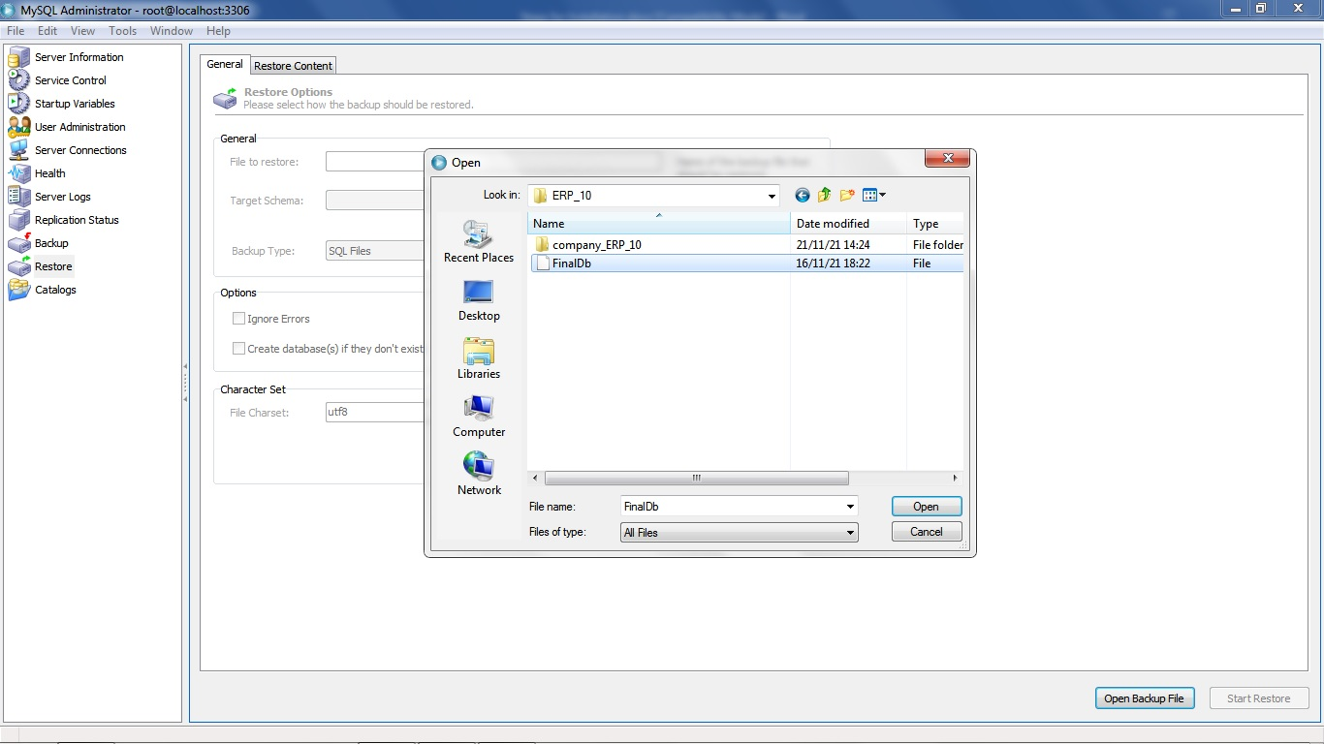
6. Deployment
Current Presenter:
Student’s Full Name
The MySQL Database backup is restored in the installed MYSLQ Software as depicted in the below steps.
Step 1: Select the database.

Slide 34
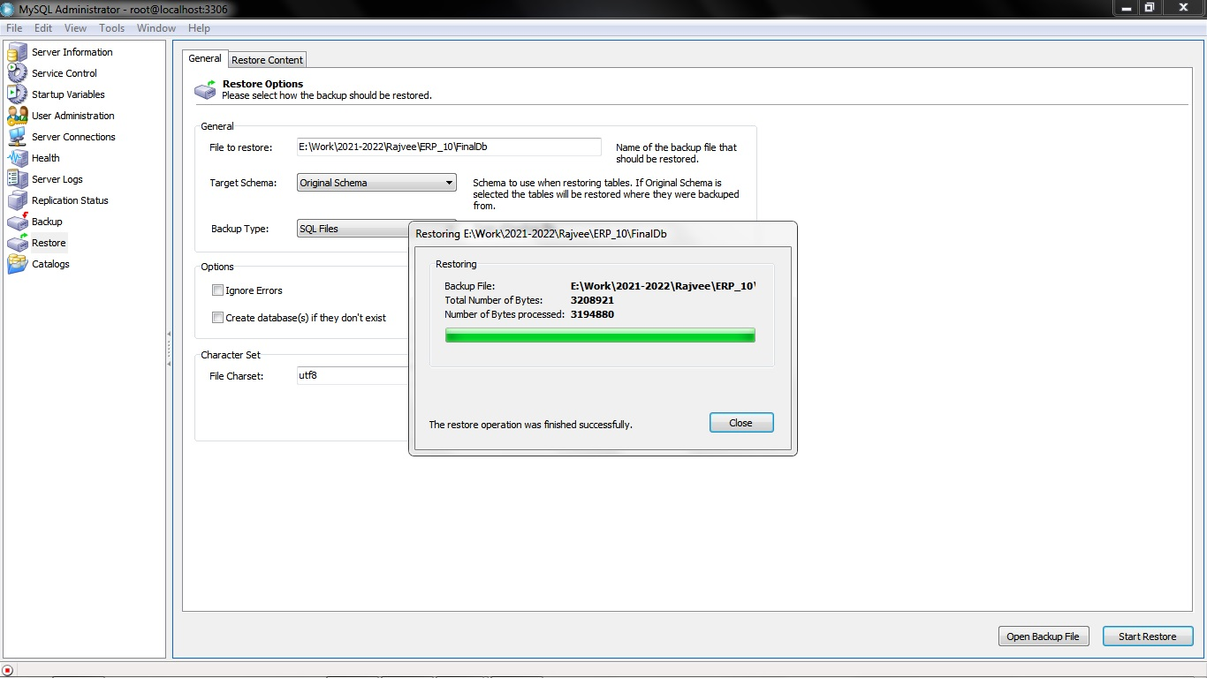
6. Deployment
Current Presenter:
Student’s Full Name
Step 2: Restoring the database.

Slide 35
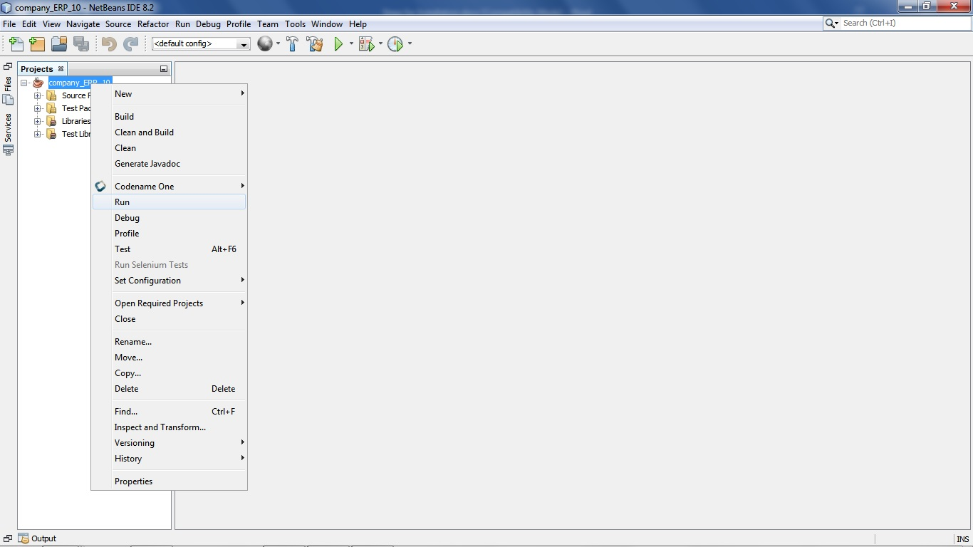
6. Deployment
Current Presenter:
Student’s Full Name
The ERP software is executed in the NetBeans IDE through the steps below.
Step 1: Execute the System.

Slide 36
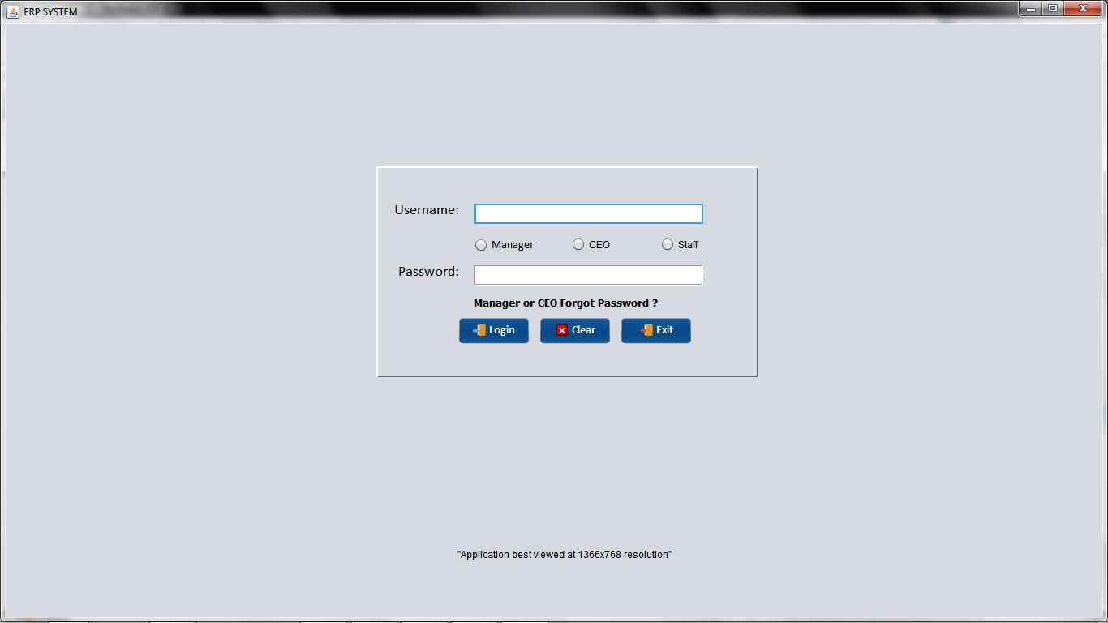
6. Deployment
Current Presenter:
Student’s Full Name
The ERP software Welcome login page.

Slide 37
7. Lesson learned
Current Presenter:
Student’s Full Name
Things you learned in this class
Effective use of the java programming language
Evaluating the paradigm of ERP’s for small scale industries
Deployment of the User Interface using the Swing Framework
Handling authentication and validation of 3 different type of users namely CEO, Manager and Staff
Maintaining different Database transaction successfully in MySQL database server
Successfully achieving an error free and useful ERP for small businesses using elaborate Test cases

Slide 38
8. Conclusion
Current Presenter:
Student’s Full Name
Client’s feedback
The students have been effectively learnt the usage of java programming language for ERP development
The progress made throughout the development by each and every student has been extremely remarkable.
The finished software is according to our requirements and has shown to adhere to very tight tolerances in quality and performance.

Slide 39
Q&A

